Slide 1
Targeted Early Numeracy (TEN) Intervention Program Information for Communities and Staff
Please grab yourself a tea or coffee before we get started..

Slide 2
About the program
The Targeted Early Numeracy (TEN) program fulfils a previous Government commitment to provide support for students experiencing substantial difficulty in learning numeracy in the early years.
TEN complements the regular numeracy programs, Count Me In Too (CMIT) and the Kindergarten Best Start Numeracy Assessment.

Slide 3
How does TEN connect?
Programs
Content
Assessment
and
Tracking Tool
Maths Syllabus
TEN
Best Start / PLAN
C.M.I.T.
Numeracy Continuum
TOWN

Slide 4
Why the change?
Education has changed!
Working
Mathematically become the focus.

Slide 5
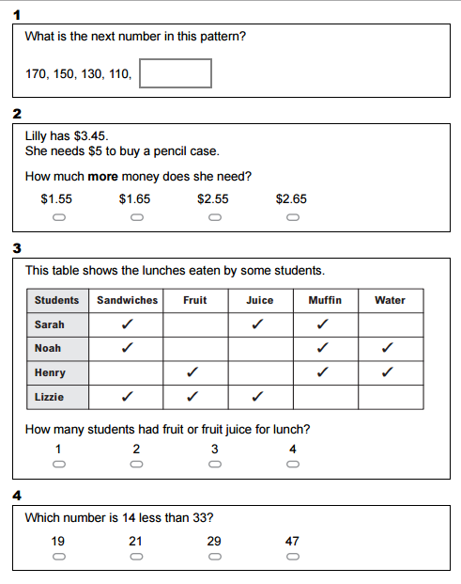
NAPLAN Year 3
‘NAPLAN
is not a test of content.
It tests skills in literacy and numeracy that are developed through the school curriculum. NAPLAN tests identify whether all students have the literacy and numeracy skills that provide critical foundations for their learning.’

Slide 6
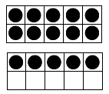
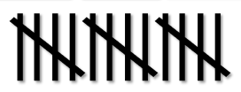
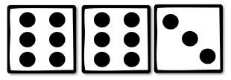
A TEN trained child knows…
5 + 5 + 5
= 15
3 + 3 + 3 + 3 + 3 = 15
3 x 5 = 15 and 5 x 3 = 15
3, 6, 9, 12, 15
3 x 5 = ?

Slide 7
The focus is on a deeper understanding!
I know that 25 minus 10 is 15.
15 minus 5 is 10.
10 plus 10 is 20.
20 plus 8 is 28.
So 25 – 15 + 18 = 28
Or.. If I minus 15 but add 18, I’m really just adding 3. so 25 + 3 = 28
Year 2 level

Slide 8
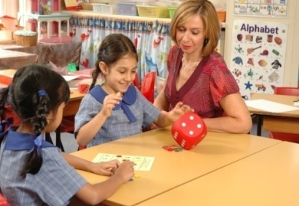
The Model
The class is organised into groups that target their C.M.I.T. levels and teach them skills to move to the next level.
Short, focused, frequent games (SFF’s) daily tasks
TEN lessons - strategically targeted activities focusing on numeracy skills which are differentiated for each C.M.I.T. level
Repetition of TEN tasks for homework
Explicit and systematic teaching partnered with mathematical discussions
Weekly reflection as a tool for formative assessment
Monitoring of student progress to identify and plan future instruction.

Slide 9
What is the Numeracy continuum?
The Numeracy continuum describes how students progress from using simple to increasingly sophisticated strategies in order to solve number and measurement problems.
It supports teachers’ understanding of how students develop numeracy concepts by providing an explicit framework of students’ strategies and understandings across critical aspects of numeracy.
Notes:
The aspects described should not be regarded as distinct from one another nor developing in a fixed order
Rather, the aspects are overlapping and interrelated
The aspects increase in sophistication going across the levels
Some aspects cover outcomes from the early years but the knowledge and skills are built on in other aspects.

Slide 10
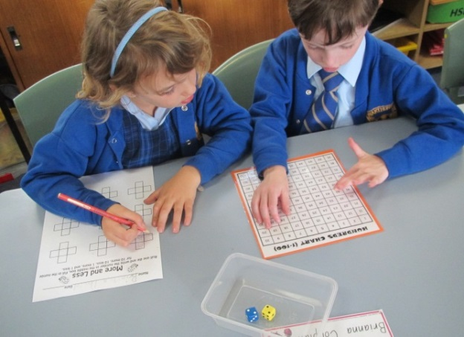
What is the Numeracy continuum?
A sequential development of key concepts in seven aspects of numeracy that can be used when observing students working on problems in mathematics:
Counting sequences
TEN focus
Early Arithmetical Strategies
Pattern and number structure
Place value
Multiplication and division
Fraction units
Unit structure of length, area, volume.

Slide 11
Numeracy Continuum Aspect 1 and 2
Aspect 1 is what they are learning.
Range for kindergarten students
Range for year 1 students
Aspect 2 is how they learn.
Range for year 2 students

Slide 12
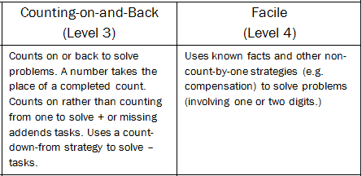
Aspect 2 - Count Me In Too Levels (C.M.I.T.)

Slide 13
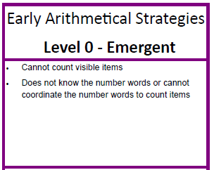
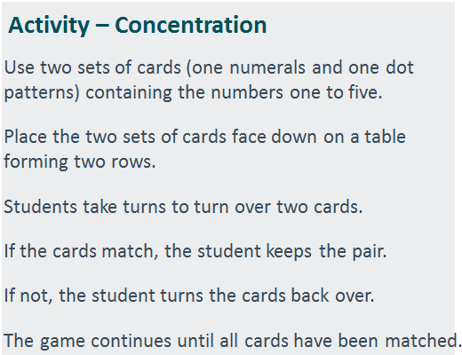
What does this look like in the classroom?
What can you do at home?

Slide 14
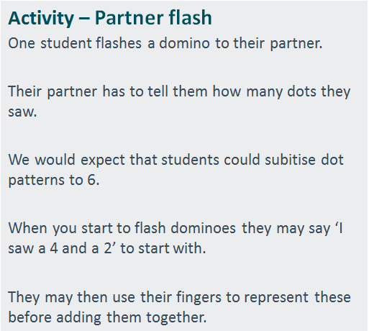
What does this look like in the classroom?
Kindergarten
What can you do at home?

Slide 15
What does this look like in the classroom?
Kindergarten – Year 1
What can you do at home?

Slide 16
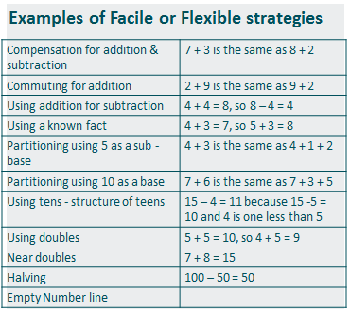
What does this look like in the classroom?
Year 1 – Year 2
What can you do at home?

Slide 17
What does this look like in the classroom?
Year 2
What can you do at home?

Slide 18
How can you help your child at home?

Slide 19
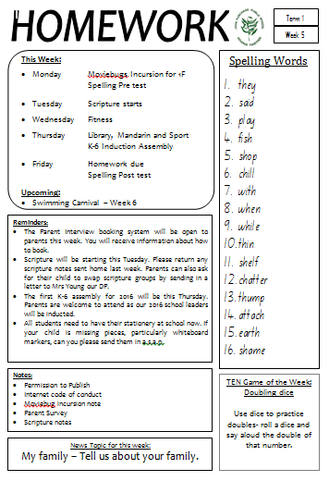
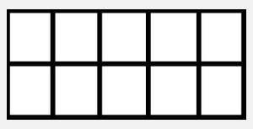
TEN Homework
What you may need….
playing cards
dominoes
dice
ten frame
Counters
100’s chart
Stage 1 Homework
includes a TEN Game.
This will have been covered in class the week before.

Slide 20
How can you help? Find numeracy opportunities in everyday activities

Slide 21
TEN Games: Salute
Students will choose a card or number from the pile. They will hold it to their forehead without looking at it.
Easy: They will ask questions about their card in a celebrity head manner.
Middle: The partner will give a simple clue i.e 2 numbers higher that 3.
High: Their partner will flip another card and add the 2 number together. The partner will tell the student the total and the student must figure out their number.

Slide 22
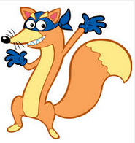
TEN Games: Swiper
Swiper has stolen
a number. Students
need to ask questions
About the stolen number to figure out which number it is. For example; is it an even number, it is higher than 20.

Slide 23
TEN Games: Race to 20
Students take turns to roll a dice and add on the number. The aim is to get to 20.
After each roll, students need to say how many more numbers they need.
For example; I have 14, I need 6 more to get to 20.
If a student needs a 4 but rolls a higher number, they miss a turn.
Make it harder: change the target number to 40, 50 or 100. Students may use their whiteboards or paper to calculate their answers.
Mini whiteboards

Slide 24
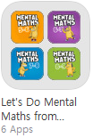
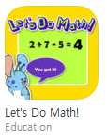
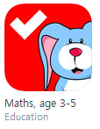
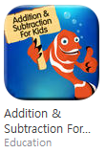
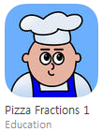
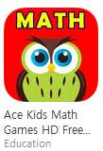
Apps for iPads
Utilising Technology
Studyladder
Skoolbo
Mathletics

Slide 25
Any questions regarding TEN?

Slide 26
Thank you for attending. Please fill in the Evaluation Form

